Slide 1


Skills for Study student guide – IP Access
www.skillsforstudy.com

Slide 2
About IP access
What you need to know:
IP access allows users to access the service on a device that is connected to a specified local network. (e.g. the institution’s campus Wi-Fi network).
Users are not required to login if the device is within the specified local network.
IP range users are required to create a personal UN/PW account using their institution email domain in order to save progress, carry out tests, bookmark pages or make journal notes.
Once a UN/PW account has been created users can access the service via UN/PW without the need to be connected to the institution IP range.

Slide 3
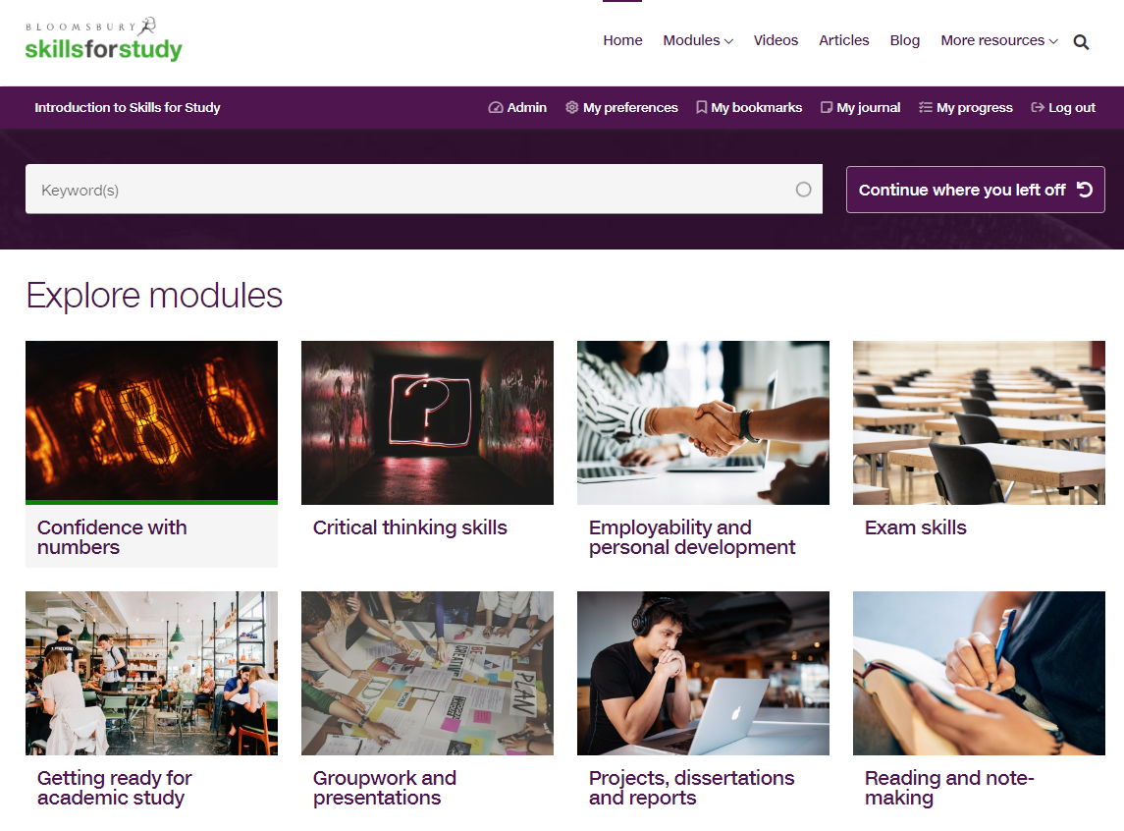
How to use Skills for Study
Head to www.skillsforstudy.com where you will see the student homepage, browse the skills you can work on, or choose from the ‘modules’ dropdown.

Slide 4
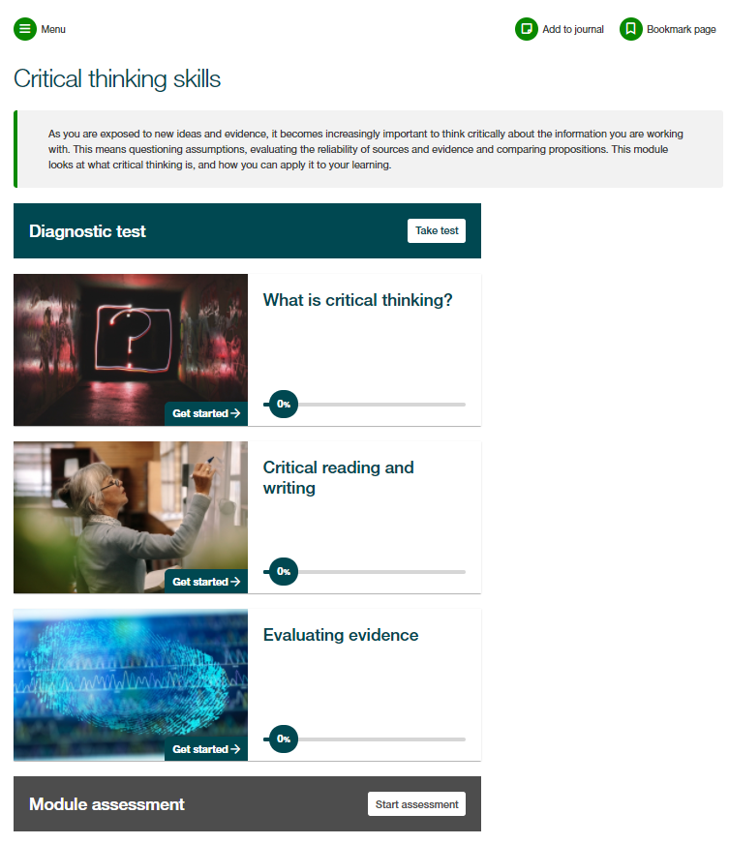
How to use Skills for Study
Each module is structured in the same way, with a module introduction, diagnostic test, sections of content and then a module assessment.
You are able to start working through the content without creating an account, but we would always recommend that you complete the diagnostic test first – this requires an account to be created.
The diagnostic test will help you to identify your strengths and areas for development so that you can prioritise your time.

Slide 5
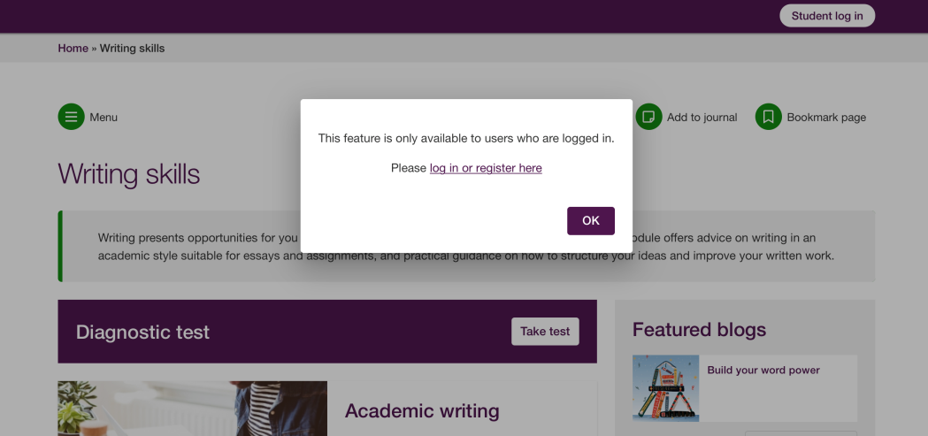
How to use Skills for Study
To carry out diagnostic tests or module assessments, save your progress, bookmark pages or create journal notes, you will be prompted to register for an account, or login if you have previously created an account.

Slide 6
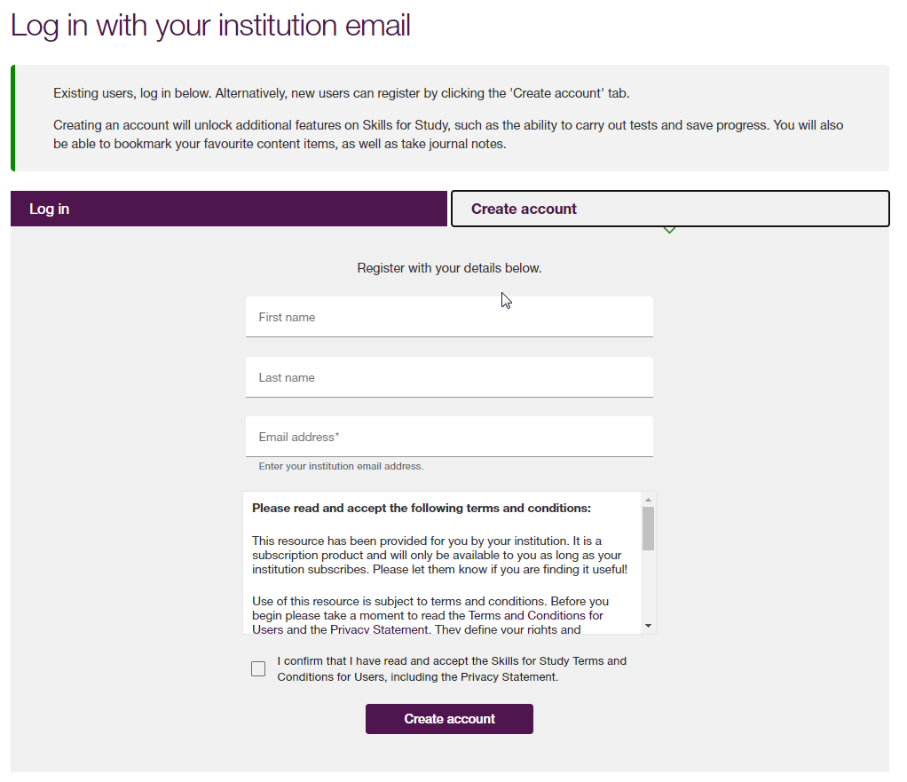
How to use Skills for Study
You will need to create an account using your College/University email address and accept the terms and conditions.
You will receive an email to the email address you entered at the account creation stage.
Click the link in the email to set your Skills for Study password.
You will be automatically logged in and directed to the student homepage.

Slide 7
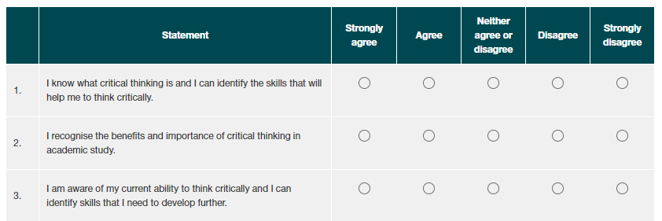
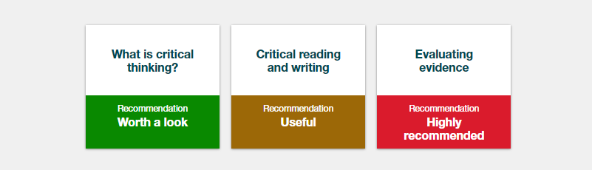
How to use Skills for Study
Once logged in, complete the survey to see your personalised recommendations.
Red shows content which is highly recommended
Gold shows content which would be useful
Green shows content which is worth a look
You can then click on the section name to go straight through to the activities and start developing your study skills!

Slide 8
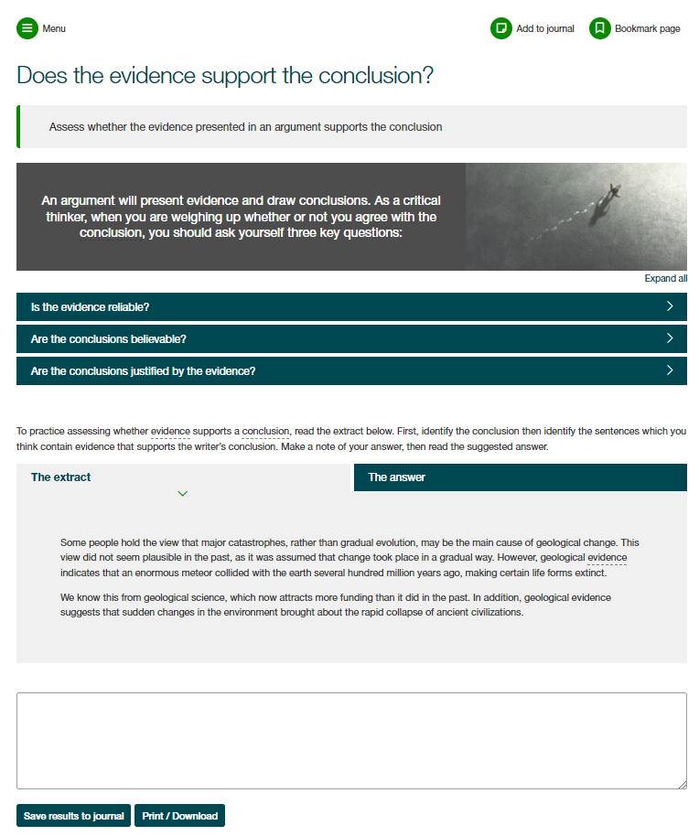
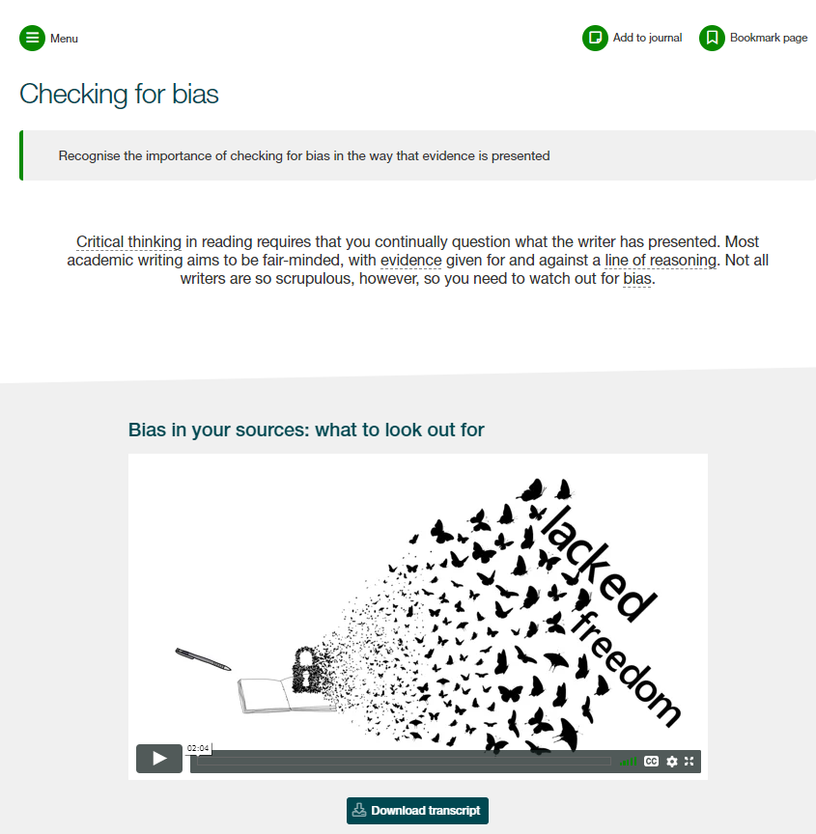
How to use Skills for Study
Work through the engaging activities and practice exercises to build your skills.
Save notes and personal reflections in your journal as you go and bookmark pages to come back to them later

Slide 9
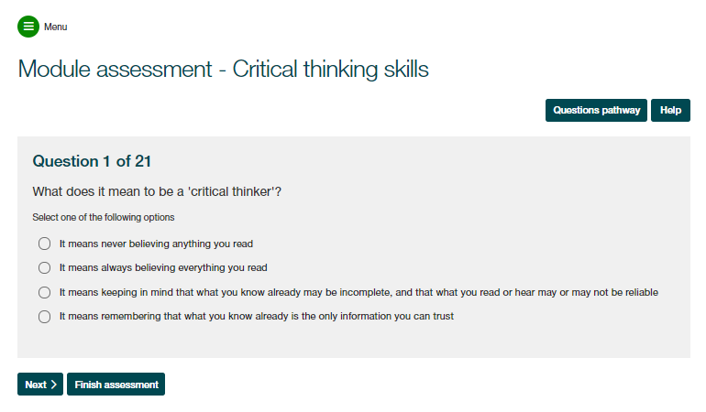
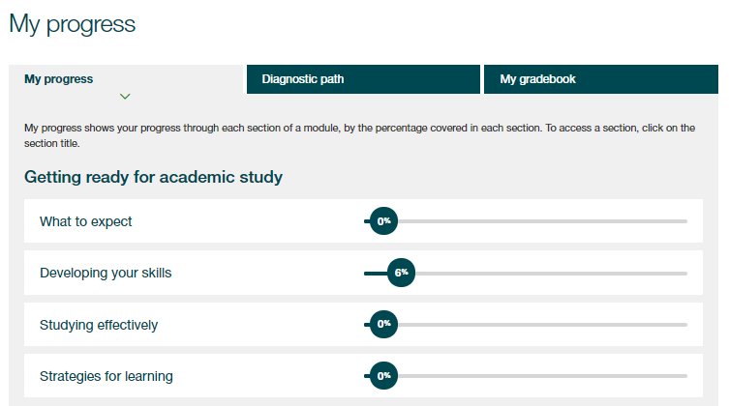
How to use Skills for Study
At the end of the module you’ll find your module assessment, which will help you put what you’ve learnt into practice and check if you’ve absorbed all the information.
Use the ‘My Progress’ section to review your completion of activities and track your assessment scores

Slide 10
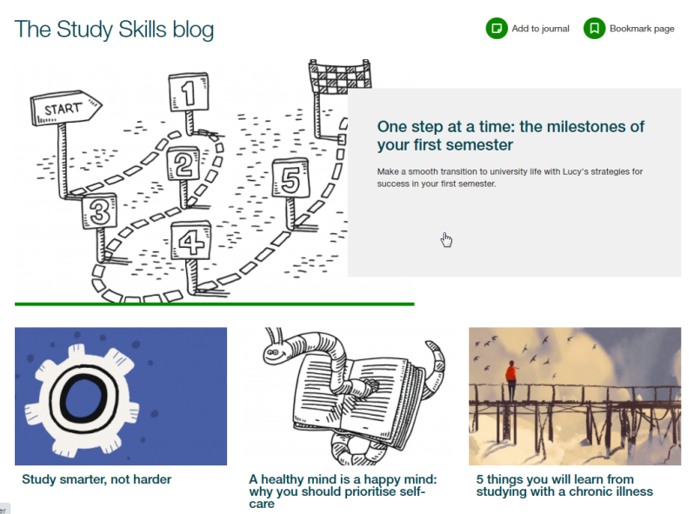
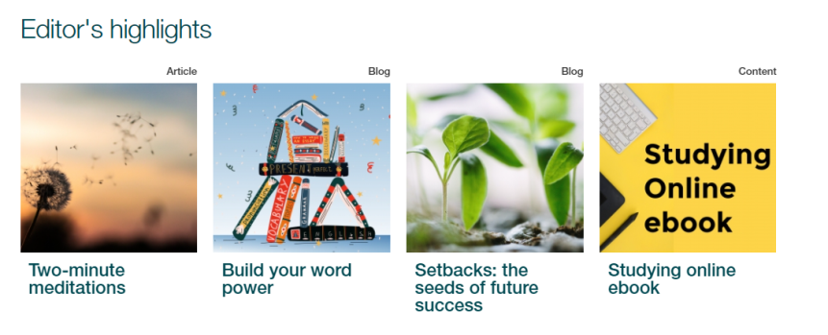
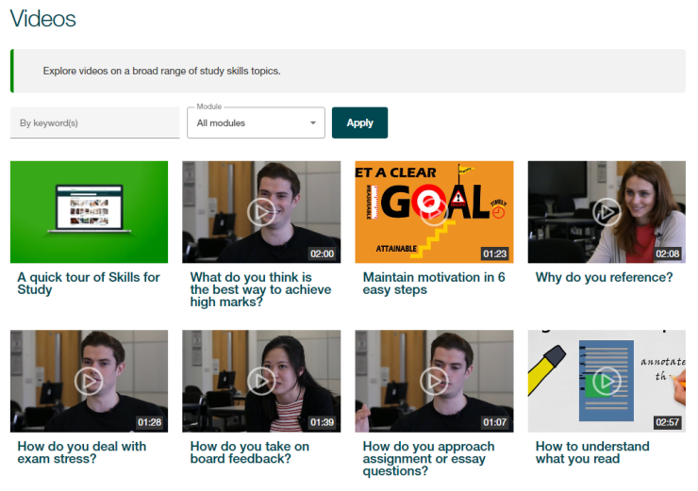
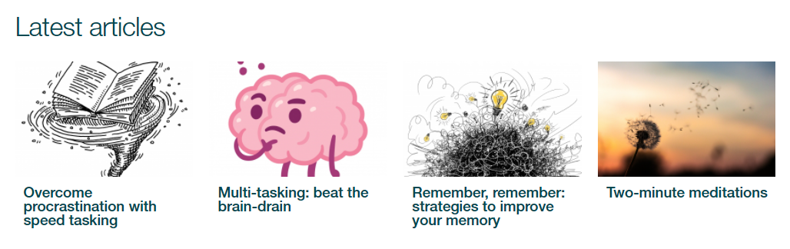
How to use Skills for Study
Explore the Editor’s Highlights, videos, blog and articles for bitesized content to boost your learning

